Slide 1
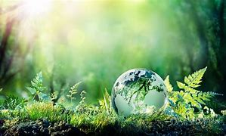
Sustainable development

Slide 2

introduction
Sustainable development can be defined as an approach to the economic development of a country without compromising with the quality of the environment for future generations. In the name of economic development, the price of environmental damage is paid in the form of land degradation, soil erosion, air and water pollution, deforestation, etc. This damage may surpass the advantages of having more quality output of goods and services.

Slide 3

Sustainable development goals
To promote the kind of development that minimizes environmental problems.
To meet the needs of the existing generation without compromising with the quality of the environment for future generations.

Slide 4
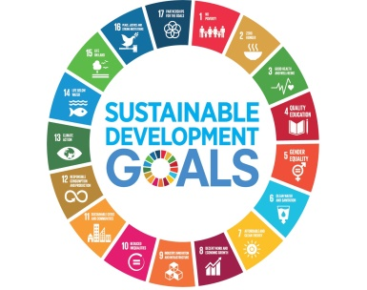
Achieving Sustainable Development
Sustainable development can be achieved if we follow the following points:
It can be achieved by restricting human activities.
Technological development should be input effective and not input utilizing.
The rate of consumption should not surpass the rate of salvation.
For renewable resources, the rate of consumption should not surpass the rate of production of renewable substitutes.
All types of pollution should be minimized.
It can be achieved by sensible use of natural resources.

Slide 5
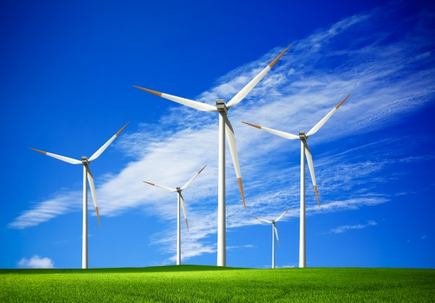
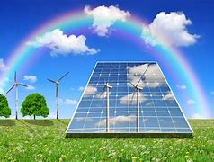
Example of sustainable development
WIND ENERGY SOLAR ENERGY

Slide 6


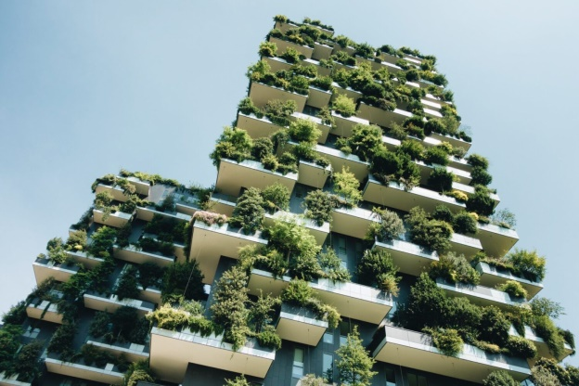
CROP ROTATION GREEN SPACE
SUSTAINABLE CONSTRUCTION

Slide 7


